Slide 1
Shock Absorbers
NATEF TASK A4 C3.1 P-2

Slide 2
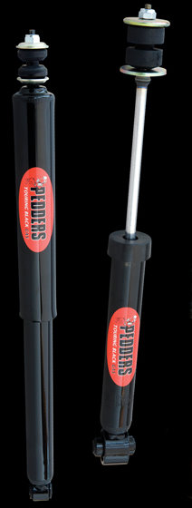
Before you start
Think!
Why are you performing this task?
What does a shock absorber do?
What are some indications that a shock needs replacement?
On which vehicle are you going to perform this task?
What tools will you need?
Where can you find the shock fastener torque specifications?
What are the most common types of shock absorbers?

Slide 3

What does a shock absorber do?
Shock absorbers limit spring oscillations to smooth out the vehicle’s ride.
Without shock absorbers, the vehicle would continue to bounce long after hitting a bump or dip in the road surface.
This loss of contact with the road surface can reduce braking and cornering effectiveness, as well as create a very uncomfortable ride.

Slide 4
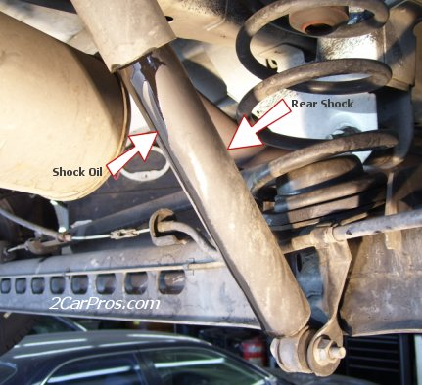
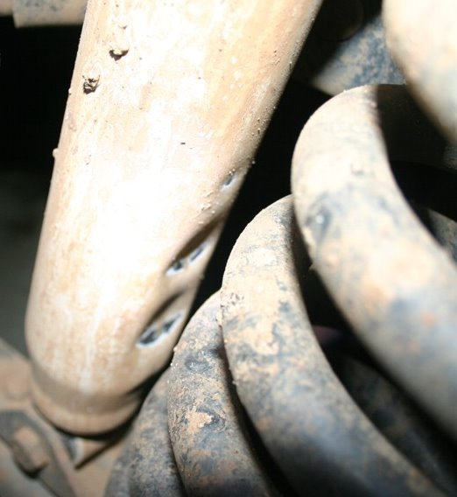
What are some indications that a shock needs replacement?
Worn shock absorbers can cause a vehicle to ride poorly, especially on bumpy roads.
The vehicle will continue to jounce and rebound after hitting bumps
Loose or broken shock absorbers can also make loud clunking or banging noises
Fluid leakage around the top of the shock absorber indicates the need for replacement
Dents or other damage are also indications of the need for replacement

Slide 5
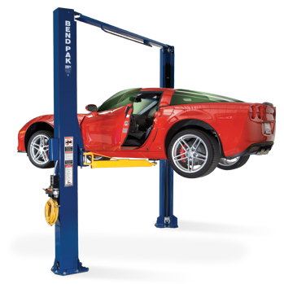
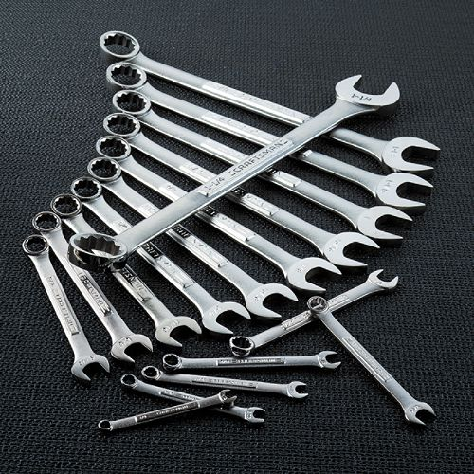
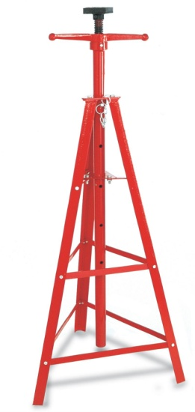
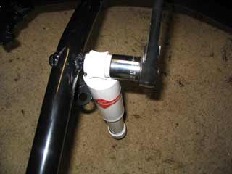
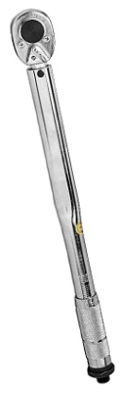
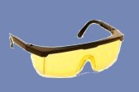
What tools will you need?
Combination wrenches
Tripod
Sockets and Torque Wrench
Hoist
Eye Protection

Slide 6
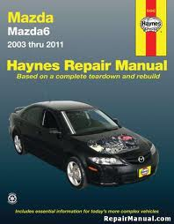
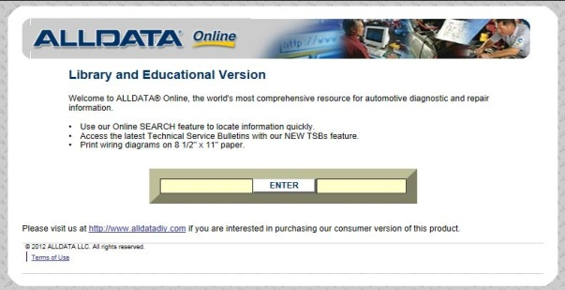
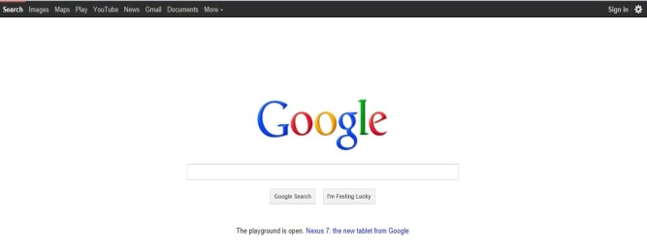
Can you find the shock fastener torque specifications?
All-Data or other service information system
Service manual for the vehicle
Google it!

Slide 7
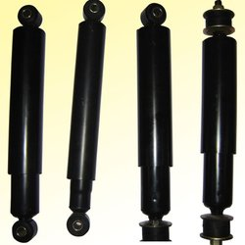
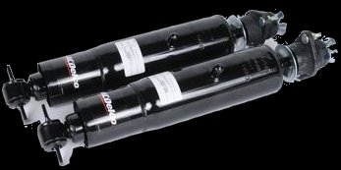
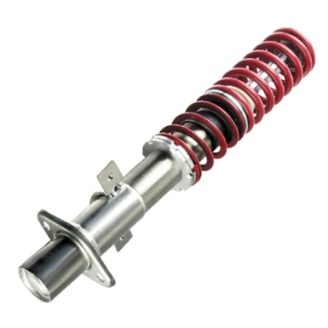
The most common types of shock absorbers
Standard Shock Absorber
Least expensive oil filled shock
Gas-Charged Shock Absorber
Gas-Charged shock absorbers use a low pressure gas to help keep the oil from foaming
Self Leveling Shock Absorber
Help maintain constant vehicle height
Adjustable Shock Absorber
Has adjustable stiffness for a
smooth ride or better handling

Slide 8

Documentation
Have your service writer print out the task sheets for your group
Look up shock fastener torque specifications
Help your service writer look up and print procedure for shock replacement (1 copy/group)

Slide 9
QUESTIONS?
Vance Bloom
vbloom@cte-auto.net
www.cte-auto.net/NC12/index.html

